Slide 1


Preparing For GCSE Unlocking Potential: Inspiring Success

Slide 2
Year 11 Mock 1 Monday 3rd October 2025 18 Days

Slide 3
GCSE Exam Series Starts 14th May 209 Days

Slide 4
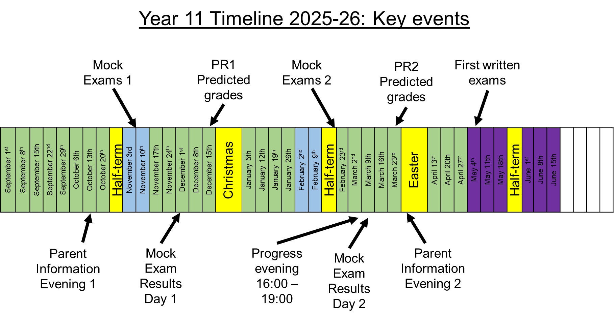

Slide 5
Revision and preparation for exams Do something now to change what happens in the future

Slide 6
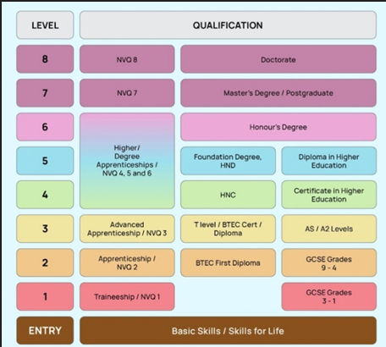

Slide 7
Effective revision will result in...
knowing the correct information and how to apply it.

Slide 8
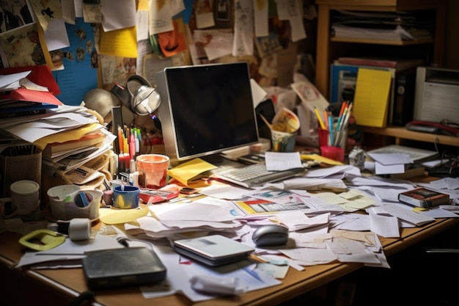
Create your Space

Slide 9
Plan your revision
Check the mock timetable
Ensure you know what is on each paper (Use the website)
Plan your revision
Build in time to revisit and adapt

Slide 10
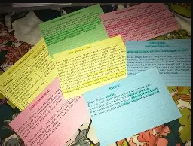
Method 1 – Flashcards
A powerful tool for recall:
Facts Formulae Quotations Dates

Slide 11
Flashcards
Method:
Use a trusted resource to create each card.
Ensure information is clear and focused on one topic per card.
Shuffle and sort.
Revisit

Slide 12
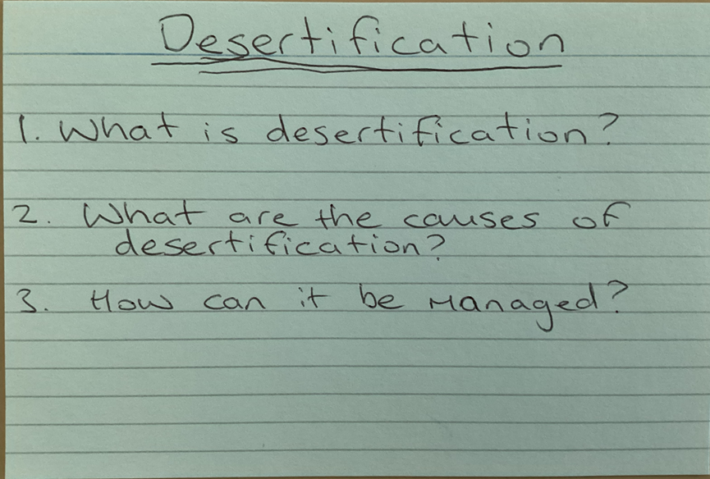
Test yourself…
Many students like flash cards – these can be problematic if you just summarise your books but can be turned into more active recall. Questions on one side…
Geography example Can be applied to all subjects:

Slide 13
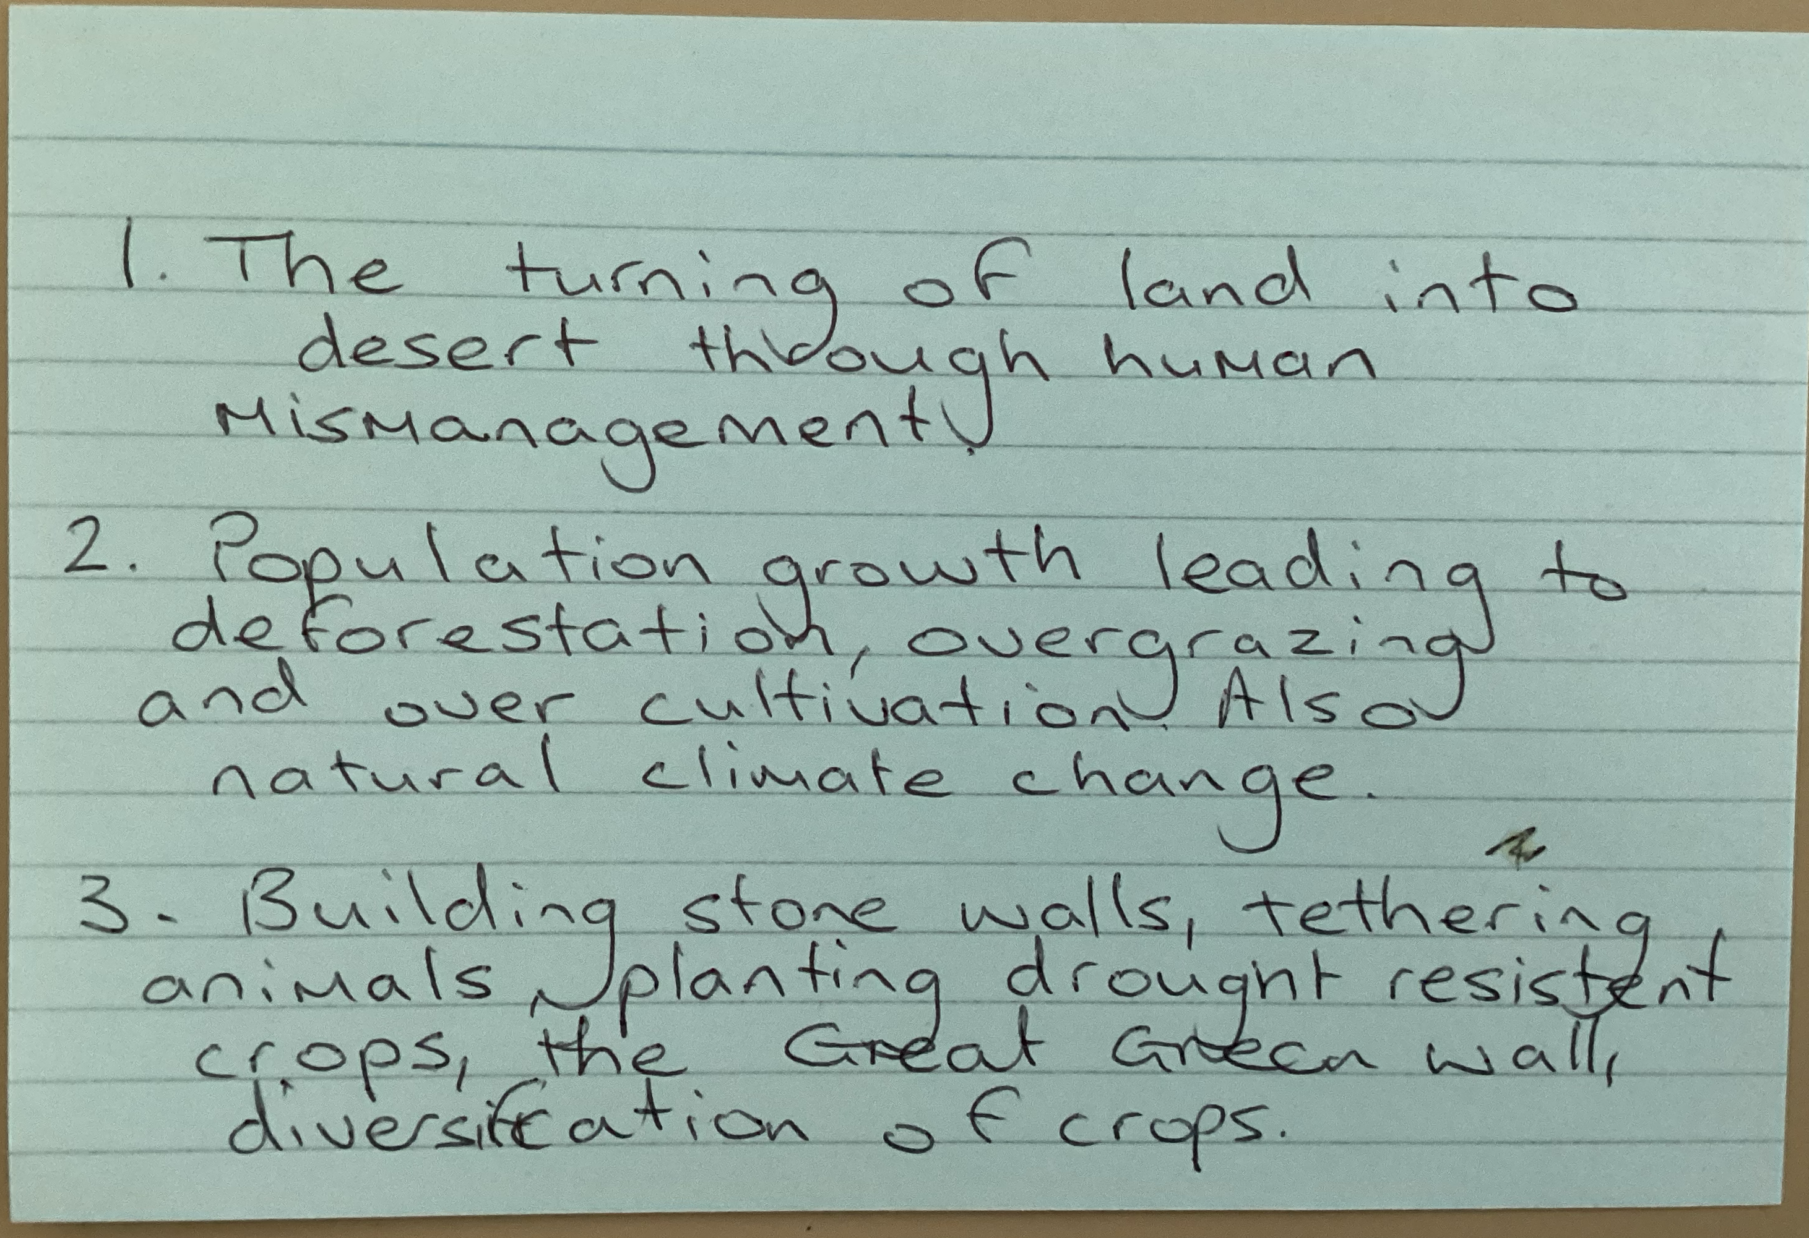
Test yourself…
Answers on the other. Quizzes are also helpful because you can also ask others to quiz you.

Slide 14

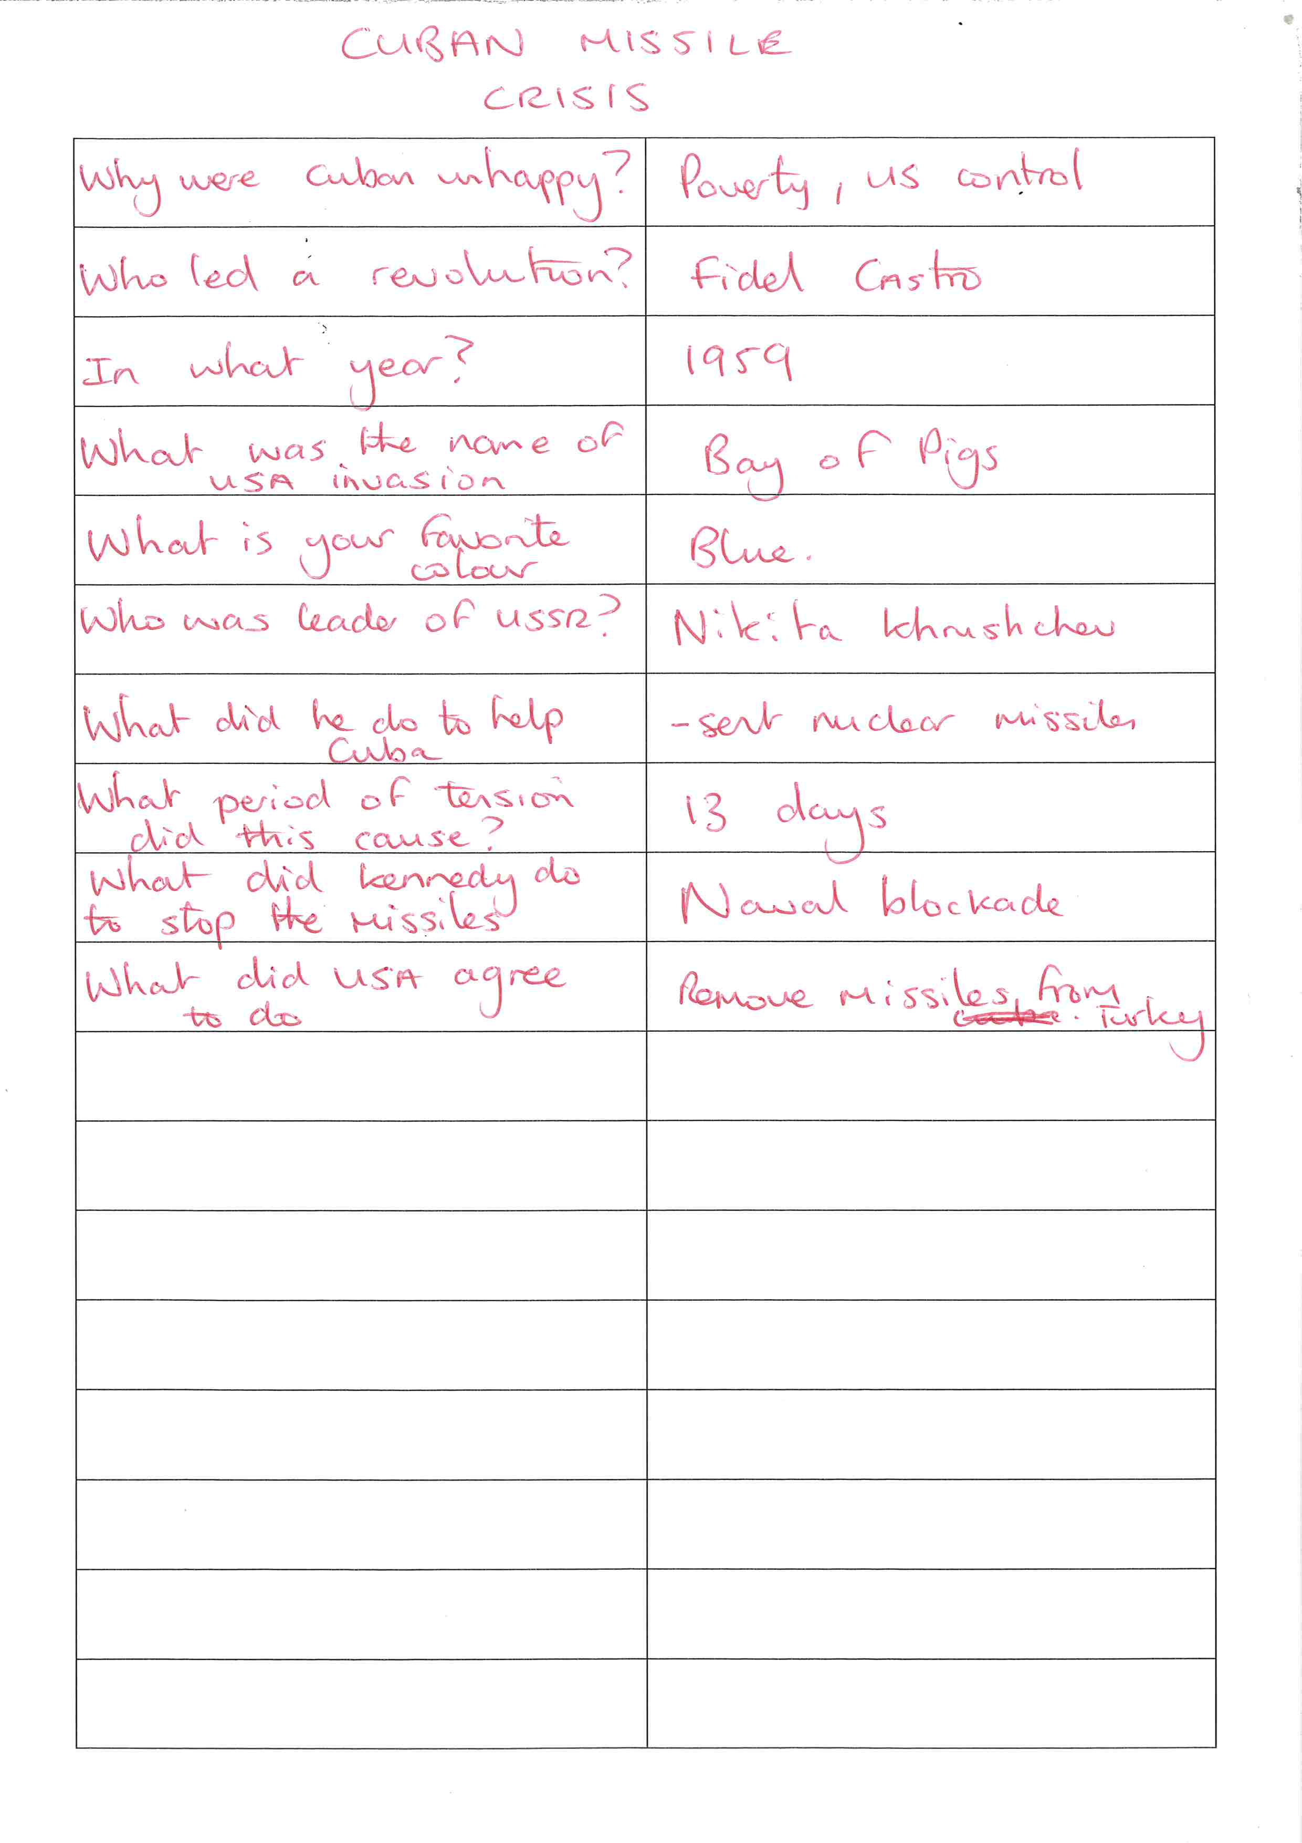
Self-Testing
Variations
As you read (or watch YouTube), write out a series of questions.
Don't ask questions that will know the answer to (what’s the point in that?).
Wait a day or two then test yourself
The example here is someone revising the Cuban Missile Crisis.
MAKE SURE TO PUT THE ANSWERS IN THIS COLUMN SO YOU CAN CHECK LATER.
History Example Can be applied to all subjects:

Slide 15
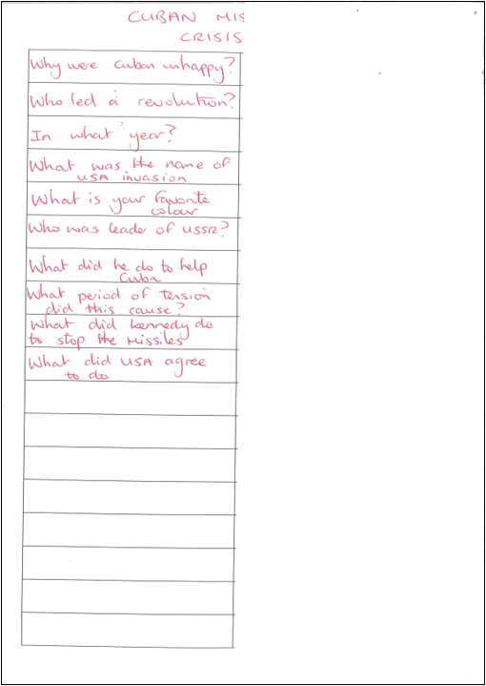
Self-Testing
Variations
In the next revision slot, cover up one side of the sheet with some paper.
Try to answer the questions from memory.
Highlight those you didn't know.
Check and retest.
History Example Can be applied to all subjects:

Slide 16
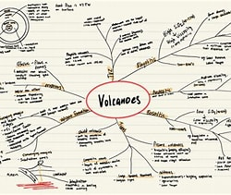
Method 2 – Mindmaps
Sorting and organising topics.
Creates a visual tool for developing understanding of facts.

Slide 17
Mindmaps
Method:
Write your topic in the centre.
Research and revise the topic, making branches for sub-topics.
Continue to build information using keywords, images, short phrases, images and colour.
Test yourself and adapt.

Slide 18
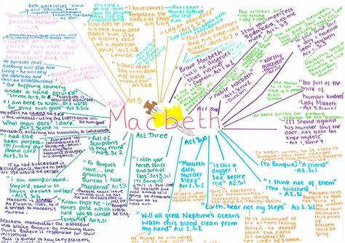
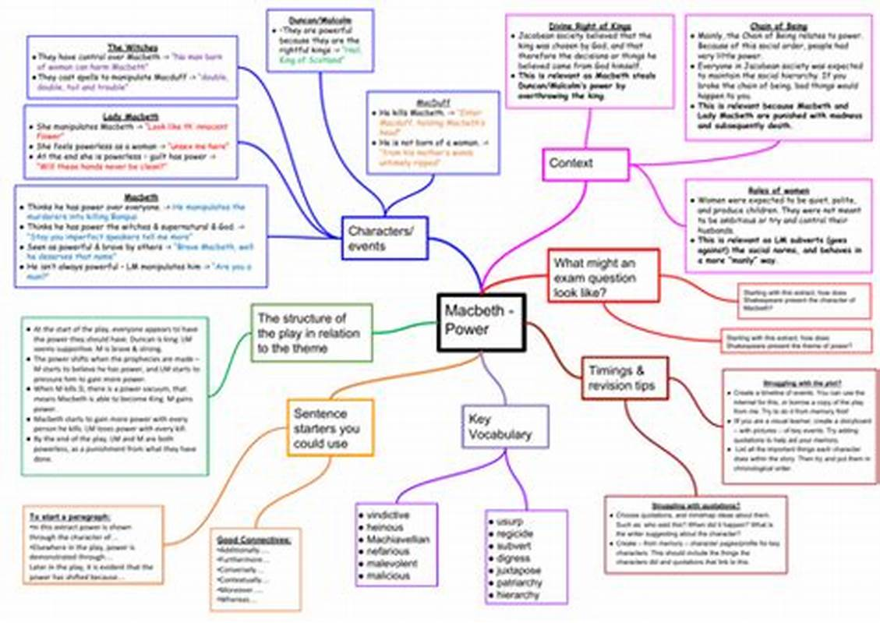
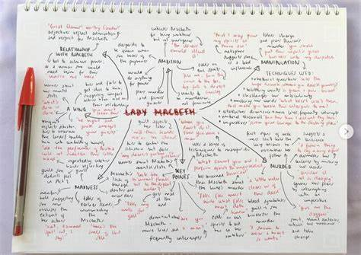
Variations
Continue and adapt by:
Creating detailed plans for characters, using higher level vocabulary.
Adding quotations.
Adapting to other Lit texts (poems by theme?)
Using online mindmapping tools to help.
NOTE: Make sure the information on the mindmap is accurate. If you're not sure, look it up!

Slide 19
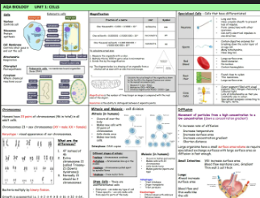
Method 3 - Knowledge organisers.

Slide 20
Knowledge Organisers
Method:
Research a topic.
Write key information on all parts of the topic, organised into sections.
Include key words.
Use to support exam question responses.

Slide 21
Animal cells
Cell membrane
cytoplasm
nucleus
mitochondria
ribosomes
Plant cells
same as animal
PLUS
cell wall
Vacuole
Chloroplasts (some)
Bacterial cells
cell membrane
cytoplasm
cell wall
plasmid
loop of DNA
NO NUCLEUS OR MITOCHONDRA
Specialised cells
sperm
nerve
xylem & phloem
muscle
root hair
Cell cycle
cell grows in size
replicates sub cellular structures
replicates DNA
one copy of chromosomes moves to each end of cell
nuclear and cell membranes divide forming 2 genetically identical cells
Cell Biology
Stem cells
Undifferentiated cells – can divide to produce more stem cells and can differentiate into many other types of cell
Active transport
Movement of substances against the concertation gradient – requires energy
Diffusion
Movement of particles from area of high to area of lower concertation
Exchange surfaces
Plants
Intestine
In fish
Lungs
Cell differentiation
When a cell changes to become specialised
Osmosis
Movement of water molecules across a semi permeable membrane from a dilute to a concentrated solution

Slide 22
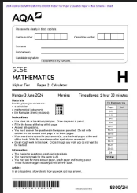
Method 4 – Timed Exam Practice

Slide 23
Exam Practice
Method:
Prepare by revising, creating materials and watching videos.
Set a timer.
Pause the timer when you need to check your revision materials.

Slide 24
Online Support
Specific searches. GCSE, Exam board, Subject, Paper, Topic/Question.
E.g. GCSE Eduqas English Literature C1, Macbeth.
2. BBC Bitesize.
3. Exam Board websites.

Slide 25


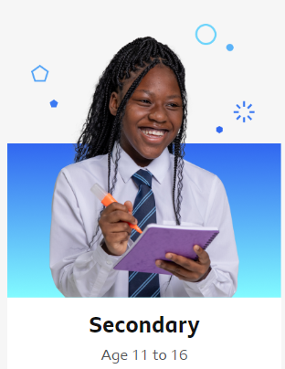
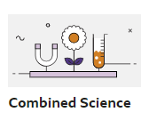
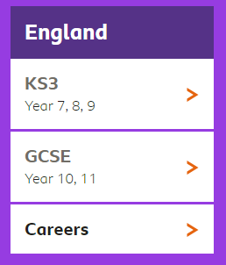
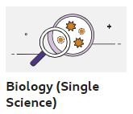

How to use BBC bitesize
From the home page…
0
Trilogy
From here you have the option of:
Podcasts
Exam practice
Biology
Chemistry
Physics
Choose the topic you want to revise and work through the revision
(videos, animations, notes and explanations)
Triple

Slide 26

Revision – Using the STAR method
S = Subject​
Curriculum Subject – eg English, maths, biology, drama
T = Topic​
Specific topic/part of the exam paper – eg Macbeth, probability, cells, staging
A = Activity​
What will you DO to help you remember, improve or practise?​ eg. Flashcards to learn quotations, paper 1 practice, quiz, timed essay practice
R = Resources ​
What will you use to improve your knowledge, give you examples, make sure you are correct or find new ideas? ​e.g. Youtube video, exam board example paper, BBC Bitesize

Slide 27
In school support 2025/26
Form time booster sessions
Small group sessions
Lunchtime and afterschool sessions
Discussion with teachers
Peer support – working together
After school study space
Staff mentoring
Form tutor support
Progress Evenings

Slide 28
This week...
 | Monday | Tuesday | Wednesday | Thursday | Friday
Lunchtime | English Study Club Support with Homework and Revision E1 | Spanish Study Session MFL1 Geography Revision GG2 | Maths Club M3 | GCSE Art A1
Afterschool |  |  | English Language Revision E1 History Revision (Conflict USA) | Maths Club M3 Vocational Coursework IT3 Art Catchup A1 Technology T1
Independent Study Room | Library Lunchtime | Library Lunchtime | Library After School | Library After School | Library After School

Slide 29

Well-being
There are other important things!
Eating, sleeping, socialising, relaxing, exercise, brain rest...
Watch out for changes.
Get in touch with us for support.
BBC Bitesize has some excellent resources.

Slide 30
Effective Revision Strategies Do something now to change what happens in the future

