Slide 1
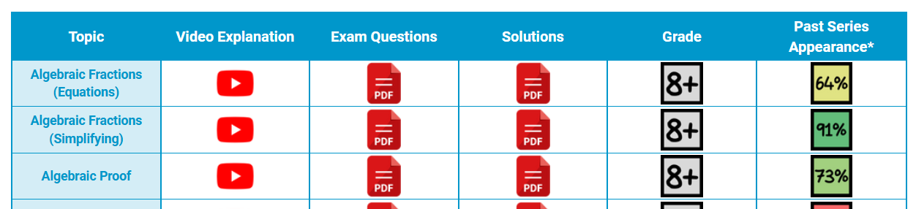
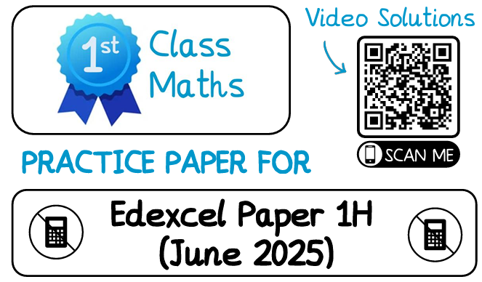
Mathematics Revision 2025
Paper 1: Thu 15 May (Non-Calculator)
Paper 2: Wed 4 Jun (Calculator)
Paper 3: Wed 11 Jun (Calculator)
Access to IT?
Topic Questions:
1st Class Maths (https://www.1stclassmaths.com/edexcelrevision)
Mathsgenie (https://www.mathsgenie.co.uk/gcse.php#google_vignette)
MrCorbett Maths (100 Days to Go)
  Foundation (https://corbettmaths.com/2024/11/30/gcse-foundation-100-days-2025/)
  Higher (https://corbettmaths.com/2024/11/30/gcse-higher-100-days-2025/)
Paper Based Practice?
Weekly exam paper from your class teacher. Use the QR code to check answers (video solutions).
Make sure you check Class Charts as a Paper 2 and Paper 3 practise paper will be released after Paper 1 2025.

